Slide 1
Customer Churn Analysis using MySql And Power BI
Md Sarique
PGA-43

Slide 2
Introduction
Overview:
This project aims to analyze customer churn, identify the key factors driving churn, and provide actionable insights to reduce churn rates
Objectives:
Understand the customer churn rate across different segments.
Identify correlations between customer characteristics and churn.
Visualize the findings using Power BI for effective decision-making.
Problem Statement:
High customer churn can significantly impact a bank’s revenue and profitability. Identifying the drivers of churn is essential for developing strategies to retain customers.

Slide 3
Data Overview
Dataset Description:
The dataset used in this analysis consists of customer records, including demographics, account information, and behavioral data. Key variables include Credit Score, Geography, Balance, Tenure, Number of Products, and Churn Status.
Key Variables:
Credit Score: A numerical value representing the creditworthiness of customers.
Geography: The region or country where the customer is located.
Balance: The current balance in the customer's account.
Tenure: The number of years the customer has been with the company.
Churn Status (Exited): Indicates whether the customer has left the company.
Data Source:
The data was imported from a MySQL database and analyzed using Power BI.

Slide 4
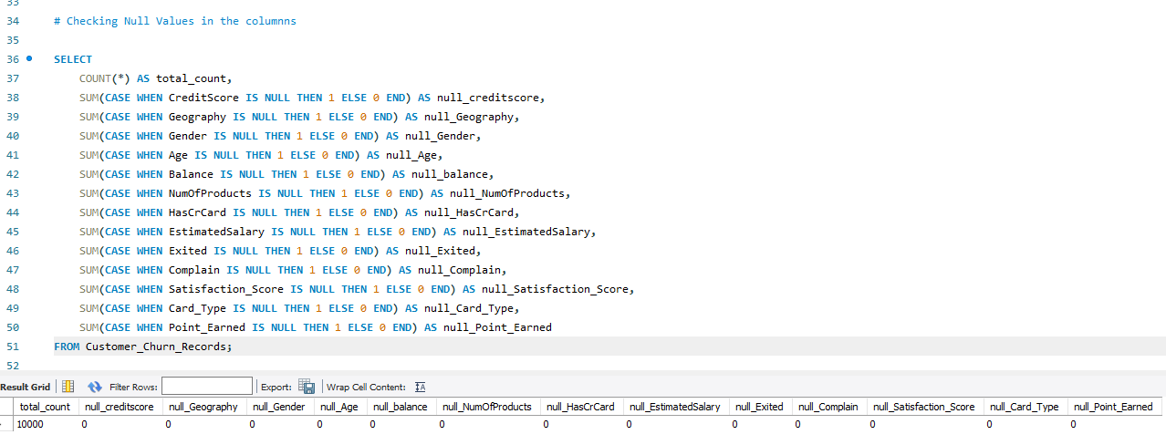
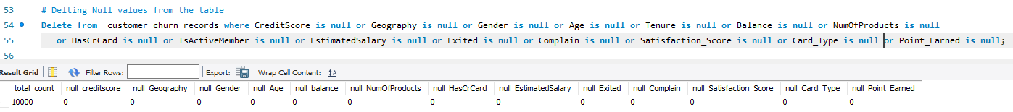
Data Preparation in MySQL
Dataset Description:
Data cleaning and transformation were performed in MySQL to prepare the dataset for analysis. Key steps included handling missing values in variables

Slide 5
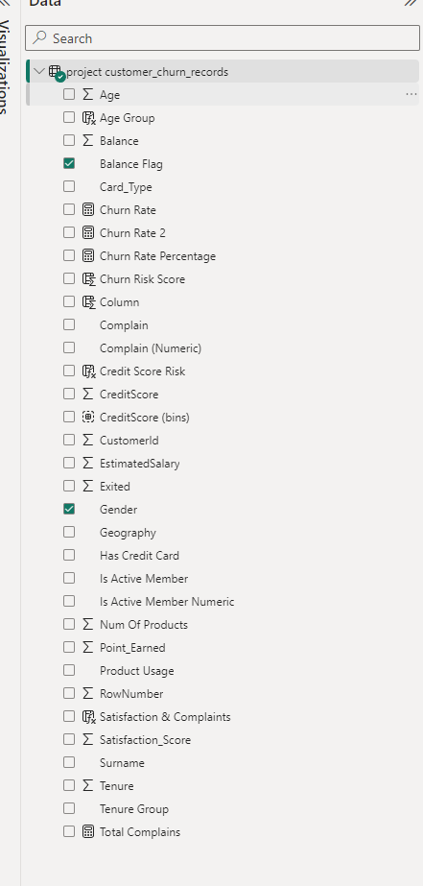
ETL Process in Power BI
Data Import :
The cleaned data was imported into Power BI using the 'Get Data' feature, connecting directly to the MySQL database.
ETL Process
Calculated columns and measures were created using DAX to facilitate deeper analysis.
The data was transformed using Power Query to create age groups, balance categories, and other meaningful segments.
Data types were adjusted within Power BI to ensure accurate calculations.

Slide 6
KPI Creation
KPI Import:
Several KPIs were created to measure factors that may contribute to customer churn. These KPIs include Tenure Group, High Balance Flag, Multiple Product Usage, Active Member Flag, and more.
Examples:
Tenure Group:
High Balance Flag:
Multiple Product Usage
Active Member Flag
Satisfaction and Complaints Combined
Credit Score Risk

Slide 7
Data Visualization
Overview :
A comprehensive dashboard was created in Power BI to visualize the key metrics and insights related to customer churn.
Key Metrics:
Overall churn rate across different geographies.
Average balance by tenure and its correlation with churn.
Churn rate segmentation by product usage and customer activity.

Slide 8
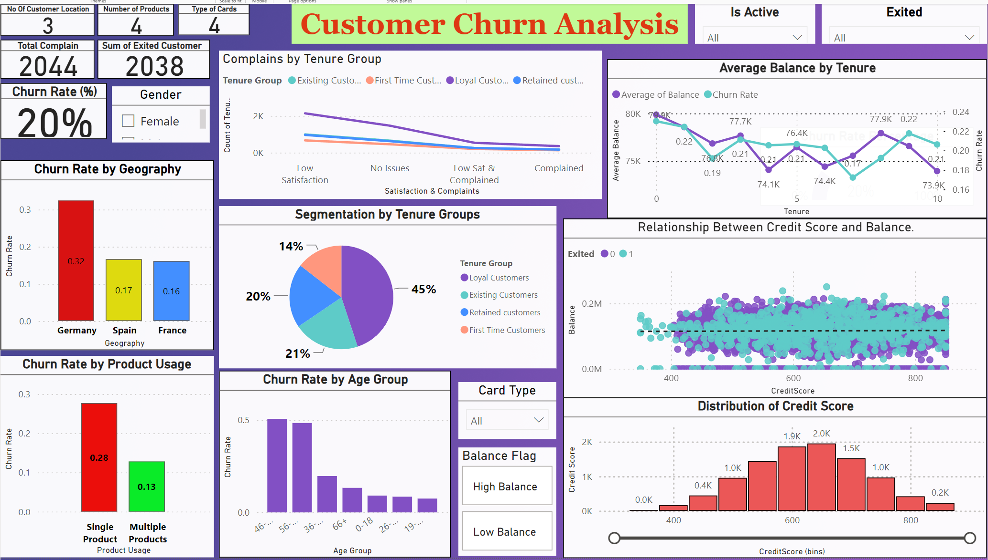
Data Overview
A comprehensive dashboard was created in Power BI to visualize the key metrics and insights related to customer churn.

Slide 9
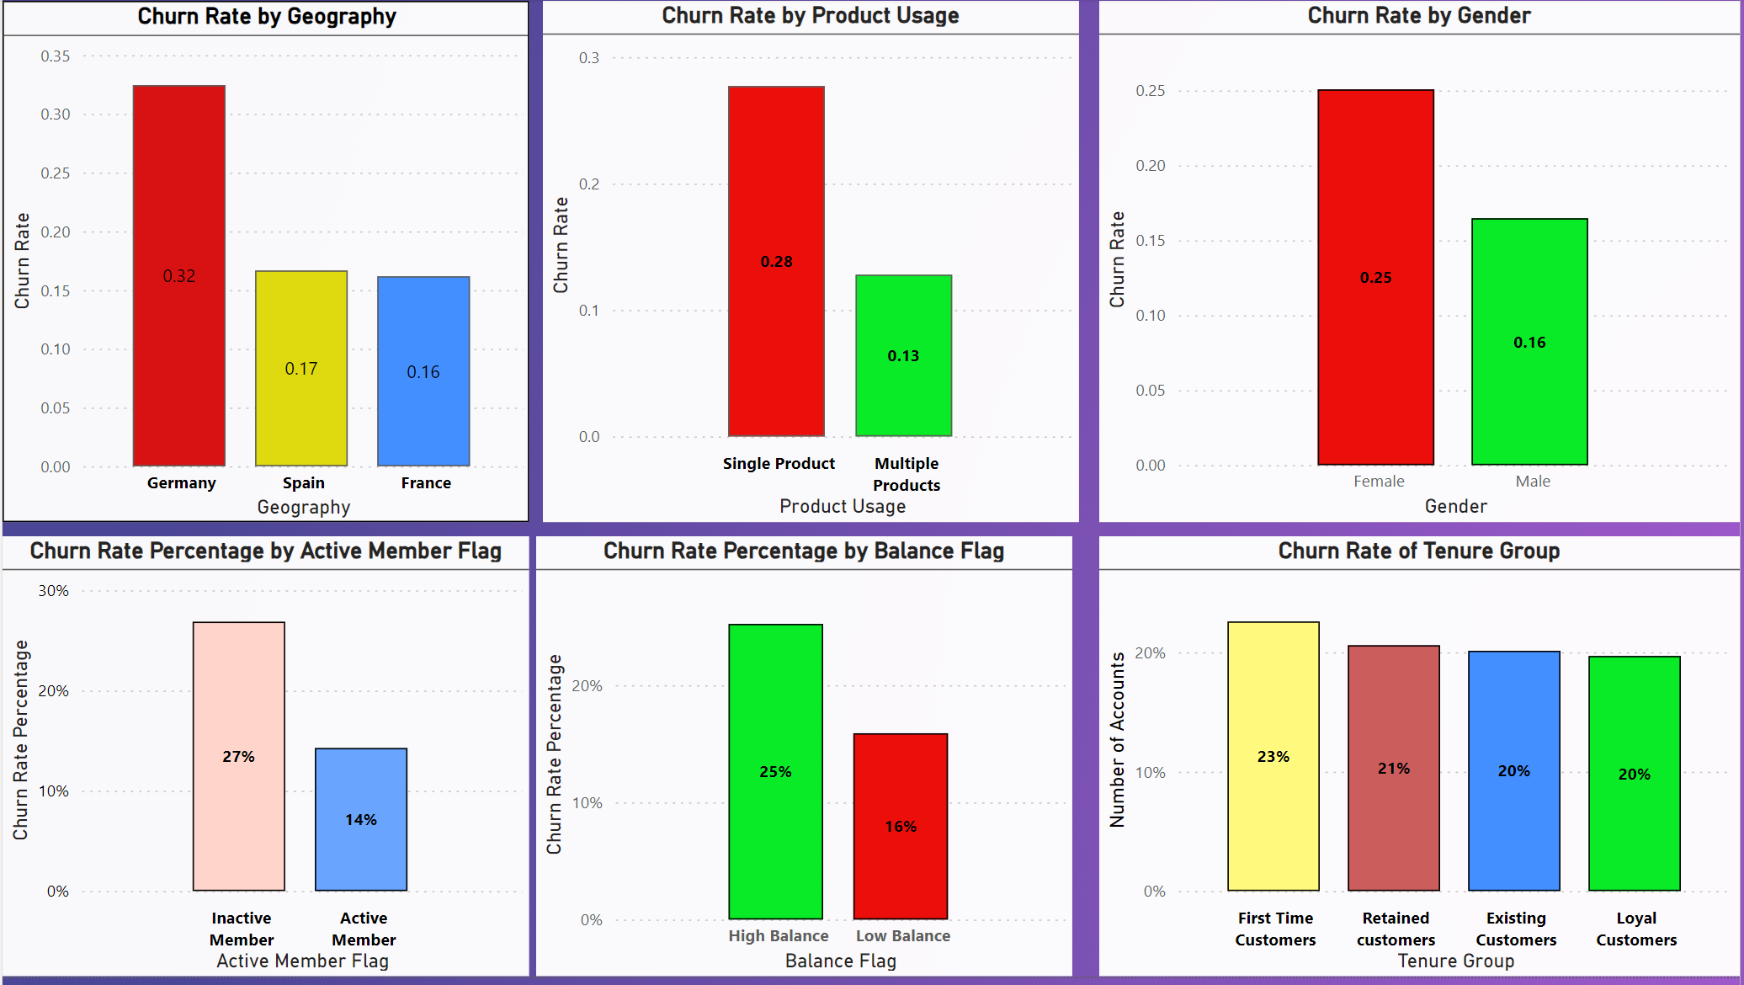
Churn Analysis
The following visualizations provide detailed insights into customer churn across various dimensions.

Slide 10
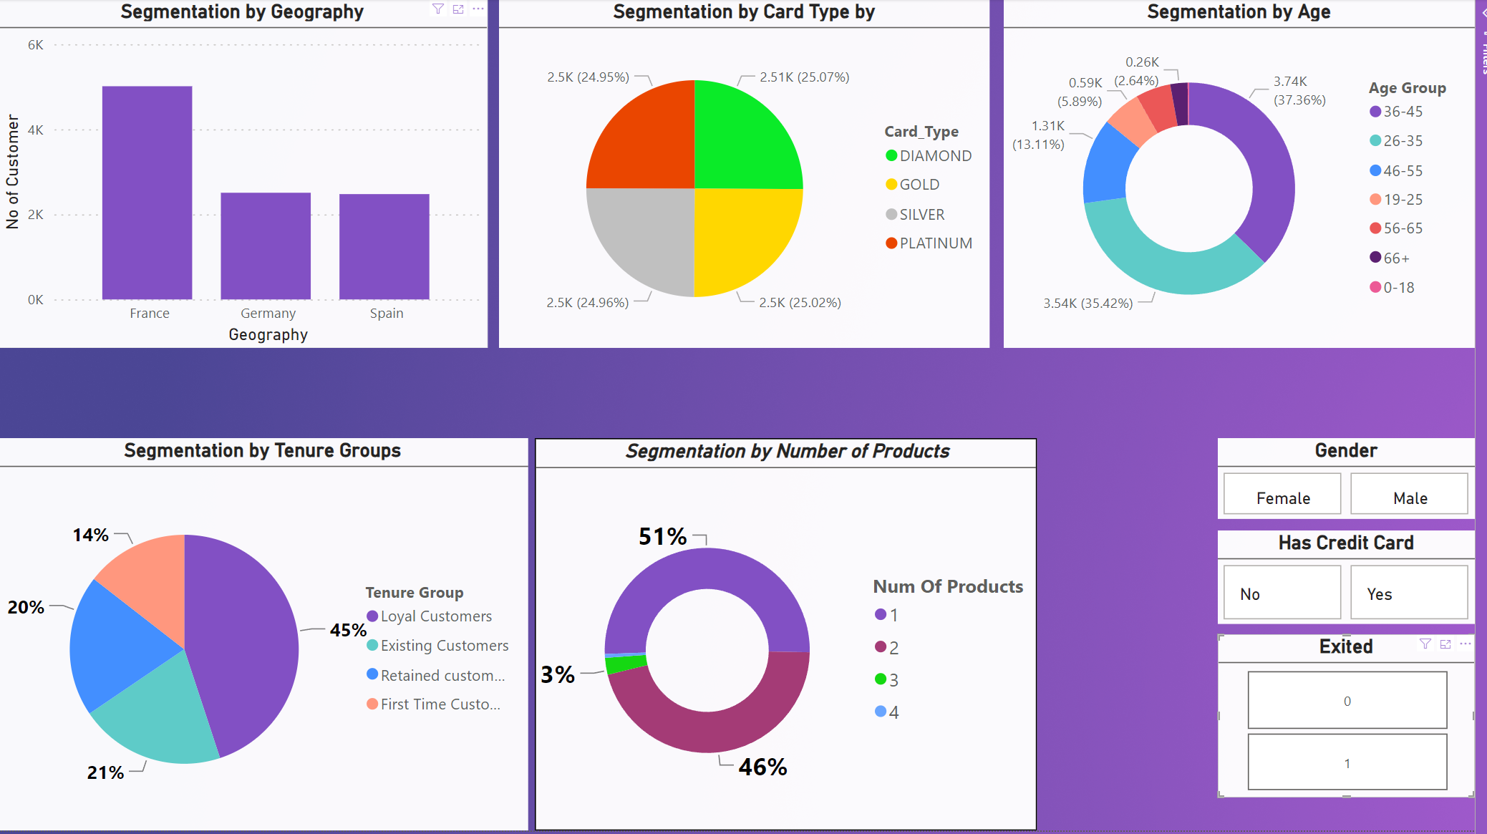
Customer Segmentation
Customer Segmentation:
Segmenting customers based on different factors allows us to understand the unique behaviors and risks associated with each group.
Key Segments:
Balance Distribution by Card Type: Reveals how balances vary across different card types.
Customer Composition by Geography: Shows the geographical locations with high number of customers
Segmentation by Age : Revels that customer of both Gender below the age of 35 Exited in higher frequency

Slide 11
Conclusion
Summary of Findings:
The analysis identified several key factors driving customer churn, including low credit scores, Gender,low balances, and lack of engagement with multiple products.
Implications:
Targeted retention strategies can be developed to address these factors.
Improving customer satisfaction and engagement could significantly reduce churn rates.
Next Steps:
Further analysis could include predictive modeling to forecast future churn and the impact of potential interventions.

Slide 12
Thank You

